Slide 1


Estimation of patient survival chances based on the medical data acquired in the first 24 hours in the Intensive Care Unit
University ”Politehnica” of Bucharest
Faculty of Electronics, Telecommunications and Information Technology
Student:
Elena-Briana BOERU, anul IV, grupa 441F
Thesis Advisor:
Conf. dr. ing. Dragoș-Daniel ȚARĂLUNGĂ

Slide 2
Agenda
Introduction to approached issue
Current needs
Chosen dataset
Project implementation
Developed models
Approached models
Models results
Conclusions
Personal contributions
Bibliography

Slide 3
Introduction to approached issue
The race for development of good estimators of patient survival is a novel topic in the engineering community and has proven to be one of the most important prospects for the advancement of biomedical technology.
Many attempts have been made in recent years to make a good prediction algorithm to help the medical community; however, the lack of varied patient data has made this effort quite difficult for different developer groups.

Slide 4
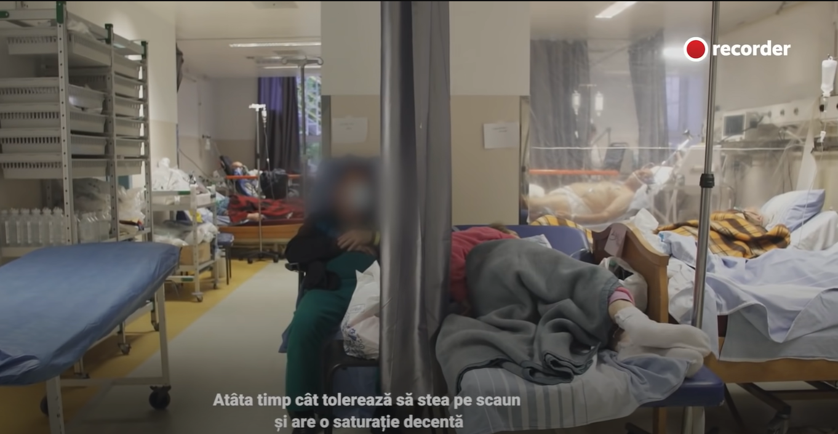
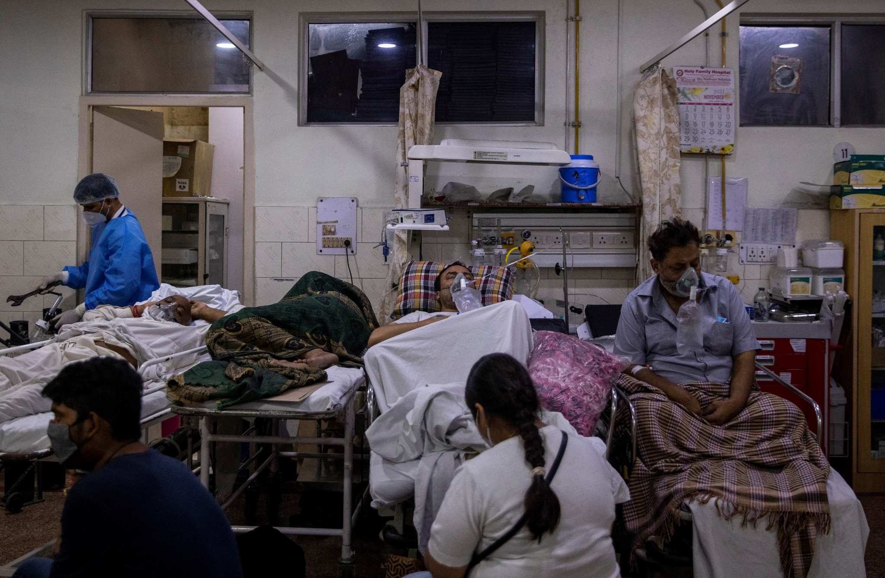
Why it is important to have such technologies?
In crisis situations, intensive care units become overloaded, which can lead to the exhaustion (burn-out) of medical personnel, the decrease in the quality of patient care and ultimately the death of the patient.
Recent and impactful crises in the intensive care units of the Romanian Health System:
COVID-19
Colectiv
International crises:
Turkey earthquake
Ukraine war

Slide 5
Currently, it has been proven that the introduction of a scoring system based on medical data acquired during the first 24 hours spent in the intensive care unit can be detrimental to a favorable outcome in terms of the patient's chances of survival.
Scoring systems such as APACHE, SAPS or SOFA that use this data already exist and are used in routine medical practice.

Slide 6
What are the current needs?
These scoring systems have been found to underperform when used in geographical regions other than those in which they were developed, and even if their results can be used as benchmarks for contemporary research, there is no doubt that the further development of new algorithms is required.
With the increase in the need for better algorithms that are general and globally valid, an additional requirement has been generated: the use of artificial intelligence components.

Slide 7



Chosen dataset
The dataset we chose for this project is from Stanford Datathon's 2020 Global Women in Data Science (WiDS), which focused on patient health through data from MIT's GOSSIS (Global Open Source Severity of Illness Score) initiative .
The challenge for this Datathon was to create a model that uses data from the first 24 hours of intensive care to predict patient survival.
This data set has privacy certification from the Harvard Privacy Lab, provided a data set of over 130,000 hospital Intensive Care Unit (ICU) patient visits over a one-year period. This data is part of a growing global effort and consortium that spans Argentina, Australia, New Zealand, Sri Lanka, Brazil and more than 200 hospitals in the United States.

Slide 8
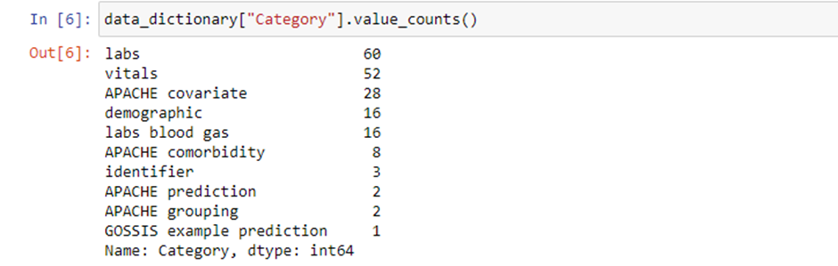
Dataset breakdown
The 130,000 inputs are divided into training data and test data, of which 91,713 are assigned to the training set and the rest are recorded to the test set. All data is labeled and the labels are recorded in a dictionary set explaining what each attribute represents.
The attribute categories are as follows:
• Labs (60 entries)
• Vitals (52 entries)
• Apache covariate (28 entries)
• Demographic (16 entries)
• Labs blood gas (16 entries)
• Apache comorbidity (8 entries)
• Identifier (3 entries)
• Apache prediction (2 entries)
• Apache grouping (2 entries)
• GOSSIS example prediction (1 entry)
Thus, we have 187 recorded attributes.

Slide 9
Project implementation
This project was implemented in Python using the Jupyter Notebook web computing platform.
Used libraries:
numpy
for numerical calculations and efficient data set manipulation
pandas
for data manipulation and analysis
seaborn
for exploratory data analysis and better looking graphics
matplotlib
for generated graphics
sklearn
for machine learning algorithms
tensorflow & keras
for developing, training and deploying machine learning models and neural networks

Slide 10
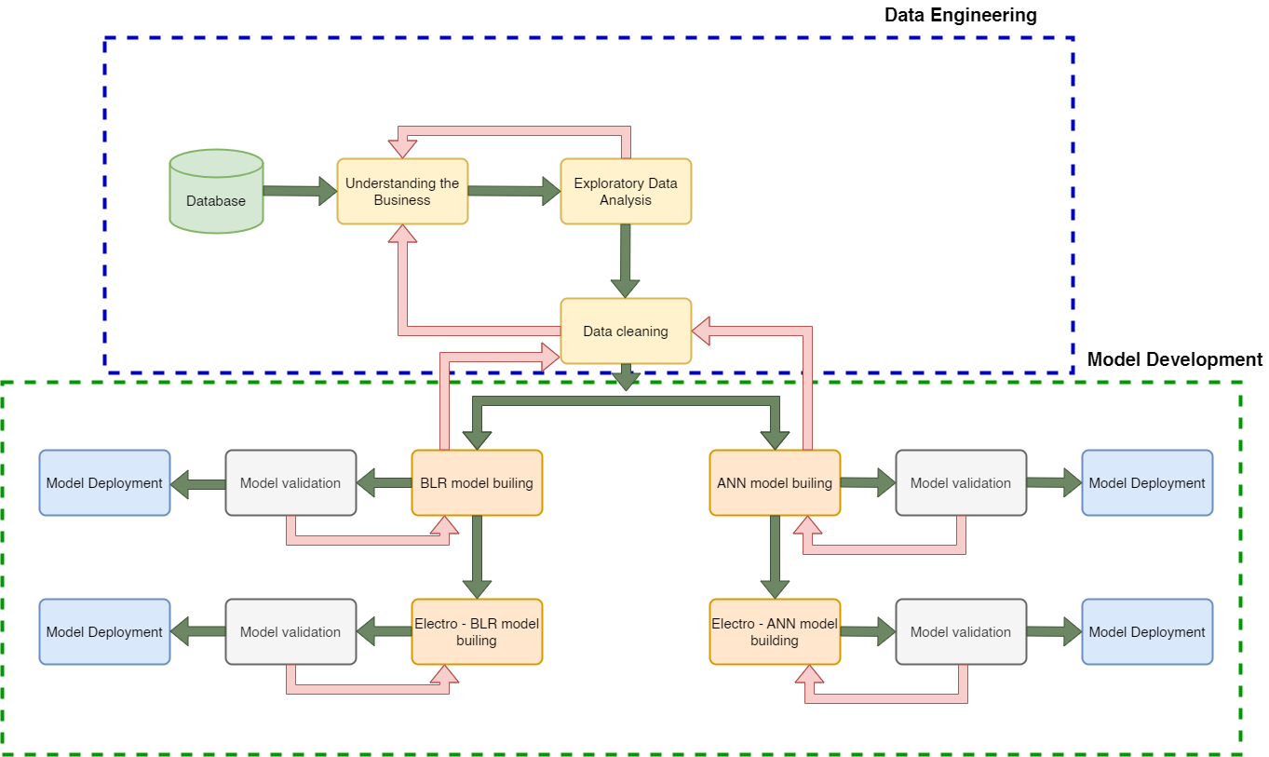
Project development process

Slide 11
Developed models
Within this project we have developed four prediction models based on the records of several recent scientific studies:
Binary Logistic Regression (BLR)
Artificial Neural Network (ANN) with Multilayer Perceptron (MLP) architecture
Electro-BLR
Electro-MLP
The difference between the first two models and those recorded with "Electro-" is the fact that in the last two models only the data that could be recorded through electronic equipment (eg "Vitals") were taken into account, respectively the data already available at hospitalization (eg. Comorbidities).

Slide 12
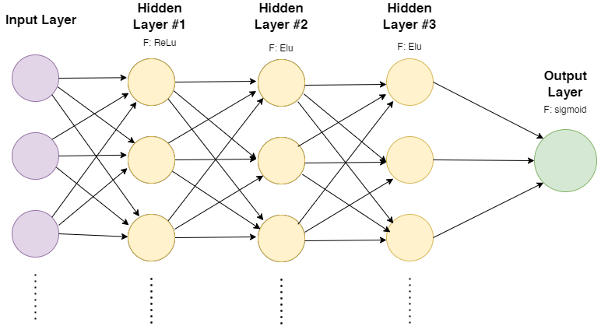
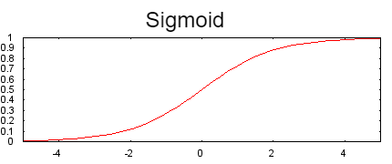
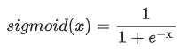

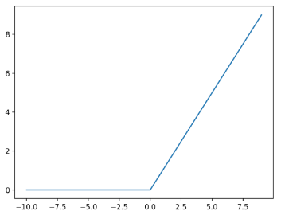
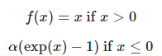

Approached models
MLP represents a feedforward network consisting of multiple layers of interconnected nodes called neurons or perceptrons. This has an input layer, an output layer (which in our case has only 1 neuron) and one or more hidden layers. Activation functions process input data and generate output data that then becomes the input to the next layer.
BLR, also called binary classification, is a statistical modeling technique that can predict the outcome of an event coded as 0 and 1 (1-dead, 0-alive). This type of logistic regression uses the sigmoid function to transform a linear combination of predictor variables into a predicted probability.
Where x represents a weighted sum of the input values.
ReLu: linear function in positive dimension and 0 in negative dimension
ELU: acts as a less complex batch normalization; contains negative values.
Unde .

Slide 13
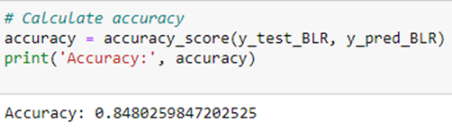
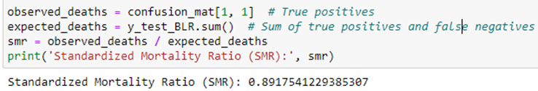
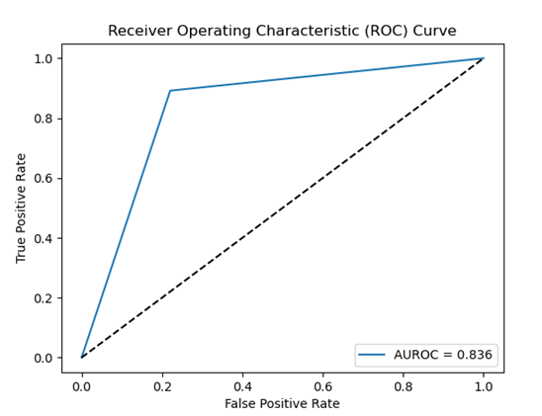
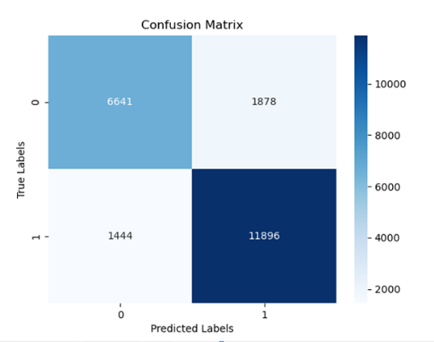
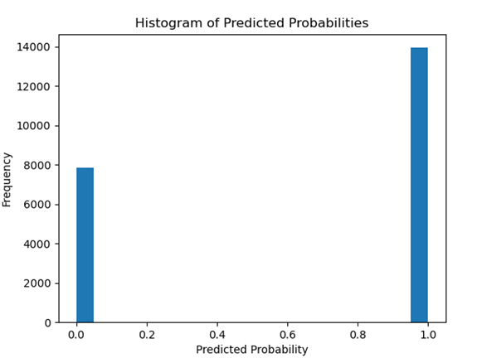
BLR results

Slide 14
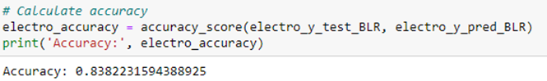
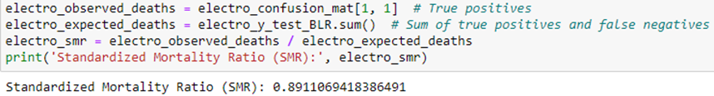
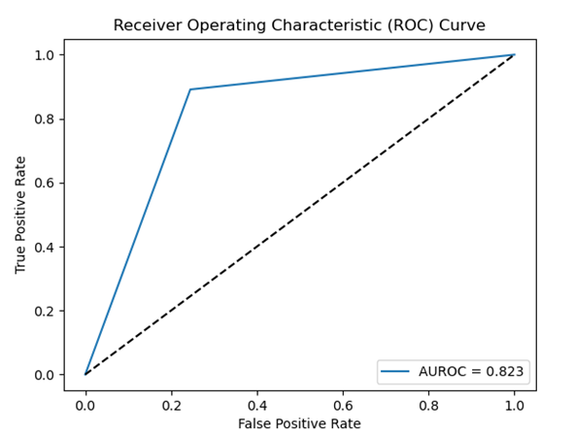

Electro-BLR results

Slide 15
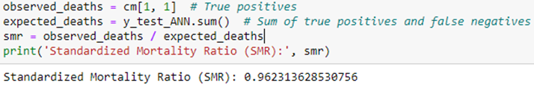
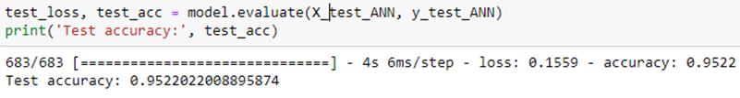
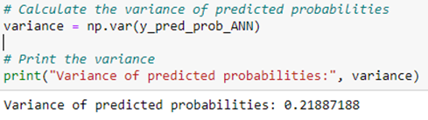
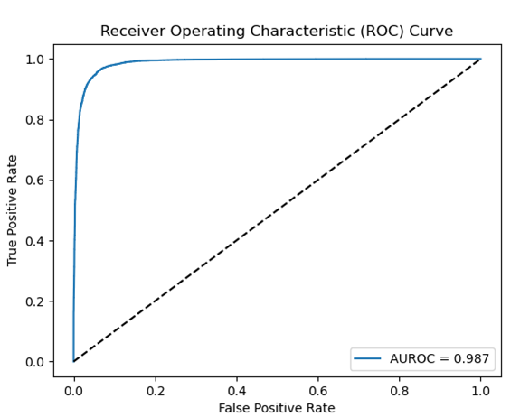
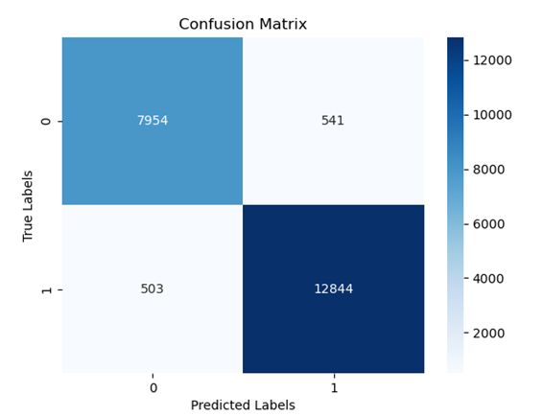
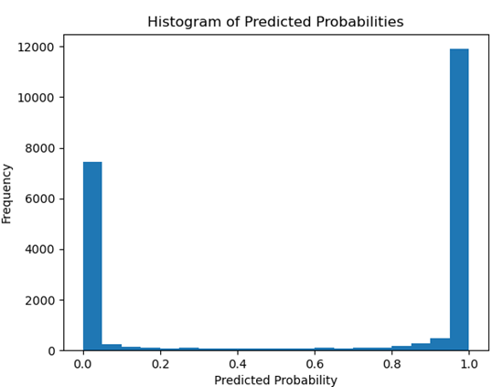
MLP results

Slide 16
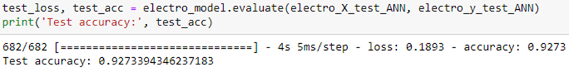
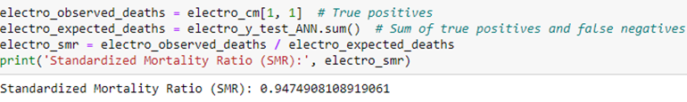
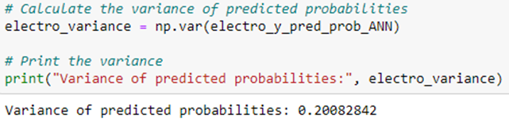
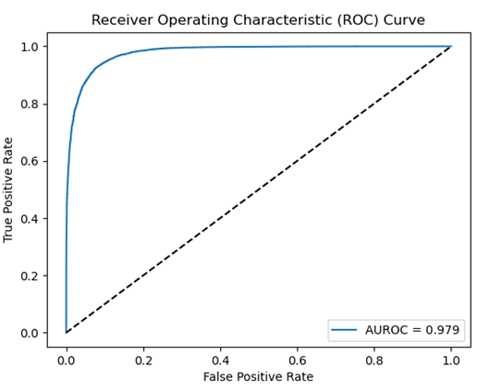
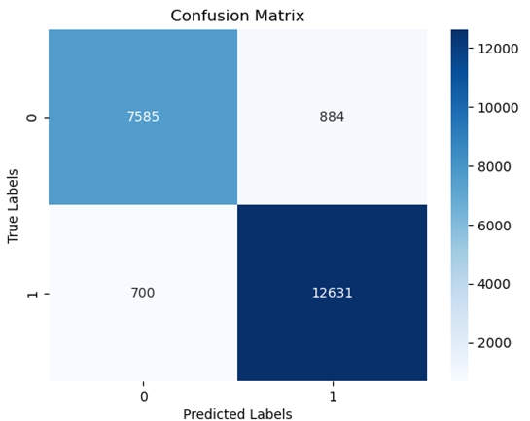
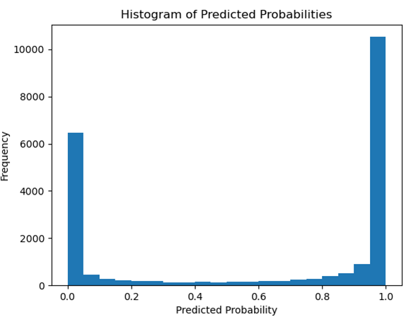
Electro-MLP results

Slide 17
Conclusions
After validating the models and analysing how the algorithms perform both accuracy-wise and in a simulated real-life environment, we can confirm the fact that the simple machine learning binary logistic regression models perform worse than the deep learning multilayer perceptron models as was presented in the State of The Art, since their accuracy is overall smaller in all of the metrics used.
On another note, our proposed theory that we could be able to develop a good enough prediction model using just the immediate electronically acquired data and the information available at the moment of admission in the Intensive Care Unit has been confirmed.

Slide 18
Personal contributions
Personal contributions include, but are not limited to:
• Extensive research of the State of The Art;
• Using a highly diverse and comprehensive database and its successful handling, without corrupting or invasively modifying the data;
• The development of personal prediction models that use regularization techniques, more layers with a varied number of neurons and multiple activation techniques;
• Formulation and validation of a hypothesis regarding the necessary attributes required to obtain optimal performances, which enables a new precondition for future works developed on the same topic;
• Successfully presenting an intermediate stage of the project in front of an accredited evaluation commission, implementing the feedback given by this entity and obtaining the third place in the Student Scientific Communication Session;

Slide 19
Bibliography
[1] R. Rigo-Bonnin et al., “Individual outcome prediction models for patients with COVID-19 based on their first day of admission to the intensive care unit,” Clin Biochem, vol. 100, pp. 13–21, Feb. 2022, doi: 10.1016/j.clinbiochem.2021.11.001.
[2] L. Famiglini, A. Campagner, A. Carobene, and F. Cabitza, “A robust and parsimonious machine learning method to predict ICU admission of COVID-19 patients,” Medical and Biological Engineering and Computing. Springer Science and Business Media Deutschland GmbH, 2022. doi: 10.1007/s11517-022-02543-x.
[3] C. Gholipour, F. Rahim, A. Fakhree, and B. Ziapour, “Using an artificial neural networks (ANNS) model for prediction of intensive care unit (ICU) outcome and length of stay at hospital in traumatic patients,” Journal of Clinical and Diagnostic Research, vol. 9, no. 4, pp. 19–23, Apr. 2015, doi: 10.7860/JCDR/2015/9467.5828.
[4] W. A. Knaus et al., “The APACHE III prognostic system: Risk prediction of hospital mortality for critically III hospitalized adults,” Chest, vol. 100, no. 6, pp. 1619–1636, 1991, doi: 10.1378/chest.100.6.1619.
[5] E. Paul, M. Bailey, and D. Pilcher, “Risk prediction of hospital mortality for adult patients admitted to Australian and New Zealand intensive care units: Development and validation of the Australian and New Zealand Risk of Death model,” J Crit Care, vol. 28, no. 6, pp. 935–941, Dec. 2013, doi: 10.1016/j.jcrc.2013.07.058.
[6] E. Paul, M. Bailey, and D. Pilcher, “Risk prediction of hospital mortality for adult patients admitted to Australian and New Zealand intensive care units: Development and validation of the Australian and New Zealand Risk of Death model,” J Crit Care, vol. 28, no. 6, pp. 935–941, Dec. 2013, doi: 10.1016/j.jcrc.2013.07.058.
[7] E. Paul, M. Bailey, J. Kasza, and D. v Pilcher, “Assessing contemporary intensive care unit outcome: development and validation of the Australian and New Zealand Risk of Death admission model,” 2017.
[12] J. Gil Cebrian, M. P. Bello Cámara, and R. Diaz-Alersi, “APACHE II.,” Intensive Care Medicine, vol. 13, no. 2. p. 143, 1987. doi: 10.1097/00003465-198603000-00013.
[16] R. Zangari, F. Biroli, and P. Gritti, “Predictors of outcome in moderate and severe traumatic brain injury,” Diagnosis and Treatment of Traumatic Brain Injury: The Neuroscience of Traumatic Brain Injury, pp. 15–26, Jan. 2022, doi: 10.1016/B978-0-12-823347-4.00001-4.
[17] J. L. McDougal, “Trauma Scoring Systems,” The Parkland Trauma Handbook: Mobile Medicine Series, pp. 18–23, Nov. 2008, doi: 10.1016/B978-0-323-05226-9.50011-6.
[18] N. M. VanDerHeyden and T. B. Cox, “Trauma Scoring,” Current Therapy of Trauma and Surgical Critical Care, pp. 26–32, 2008, doi: 10.1016/B978-0-323-04418-9.50010-2.
[31] “GOSSIS: Global Open Source Severity of Illness Score: International Benchmarking for Critical Care.” https://gossis.mit.edu/ (accessed Apr. 19, 2023).
[32] J. D. Raffa et al., “The Global Open Source Severity of Illness Score (GOSSIS),” Crit Care Med, vol. 50, no. 7, pp. 1040–1050, Jul. 2022, doi: 10.1097/CCM.0000000000005518.
[33] J. A. Hanley and B. J. McNeil, “The meaning and use of the area under a receiver operating characteristic (ROC) curve,” Radiology, vol. 143, no. 1, pp. 29–36, 1982, doi: 10.1148/radiology.143.1.7063747.
[34] “Application of Binary Logistic Regression Model to Cancer Patients: a case study of data from Erbil in Kurdistan region of Iraq.,” Zanco J Pure Appl Sci, vol. 33, no. 4, Aug. 2021, doi: 10.21271/zjpas.33.4.12.
[35] H. Ramchoun, M. Amine, J. Idrissi, Y. Ghanou, and M. Ettaouil, “Multilayer Perceptron: Architecture Optimization and Training,” International Journal of Interactive Multimedia and Artificial Intelligence, vol. 4, no. 1, p. 26, 2016, doi: 10.9781/ijimai.2016.415.
[105] Dragoș - Daniel Țarălungă, Instrumentație Biomedicală: Măsurarea și Analiza Biopotențialelor, Editura Matrix Rom, pp. 311, 2013, ISBN 978-973-755-945-6,
[106] Boeru Elena-Briana, „Estimation of patient survival chances based on the medical data acquired in thefirst 24 hours in the Intensive Care Unit”, Premiul III, Sesiunea de Comunicări Științifice Studențești, 5-6 mai
2023

Slide 20
Thank you for your attention!

